Slide 1
Anatomy of Uterus, Uterine Tube
BY: M. G. HAMMAD

Slide 2
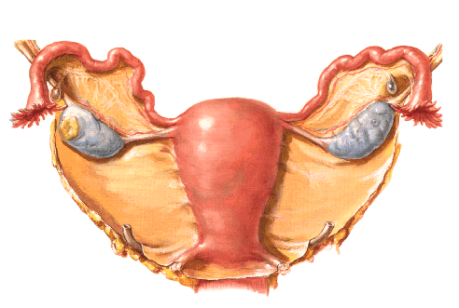
Anatomy of Uterus:
Thick-walled muscular organ.
Whose function is to provide a nidus for the developing embryo.
Measures:
8 cm (3 in) long.
5 cm (2 in) from side to side.
3 cm (1 in) thick.
Formed of:-
Fundus.
Body.
Cervix.
It receives the uterine tubes.

Slide 3
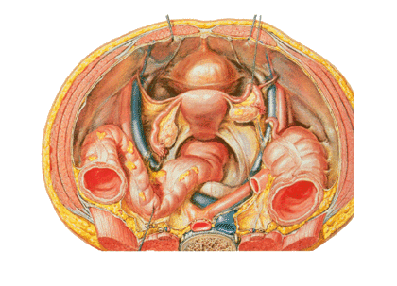
Anatomy of Uterus: FUNDUS
Above the entrance of the tubes.
It is convex and measures:
Side to side: 2 in
Thickness: 1 in
It covered by serous coat of pelvic peritoneum which continues downwards over the front and back of the body.

Slide 4
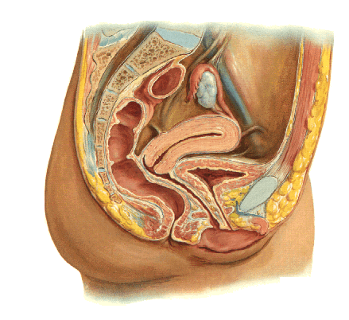
Anatomy of Uterus: BODY
Is flattened Antero posteriorly.
Each upper angle receives the uterine tube.
It is enclosed by peritoneum which laterally becomes the broad ligament.
It has 2 surfaces:
Intestinal surface: faces upwards with coils of intestine lying upon it.
Vesical surface: rests on the bladder with the peritoneum of the vesico- uterine pouch intervening.

Slide 5
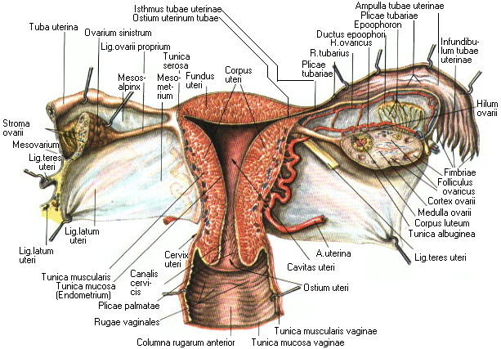
Anatomy of Uterus: BODY
Uterine cavity & Isthmus:
A narrow slit in the virgin.
Triangular in anterior view.
Enlarges during pregnancy.
The lowest half cm of the body is the ISTHMUS.
Isthmus becomes continuous with the cervix.
It called lower uterine segment {by OBS} at full term pregnancy.

Slide 6
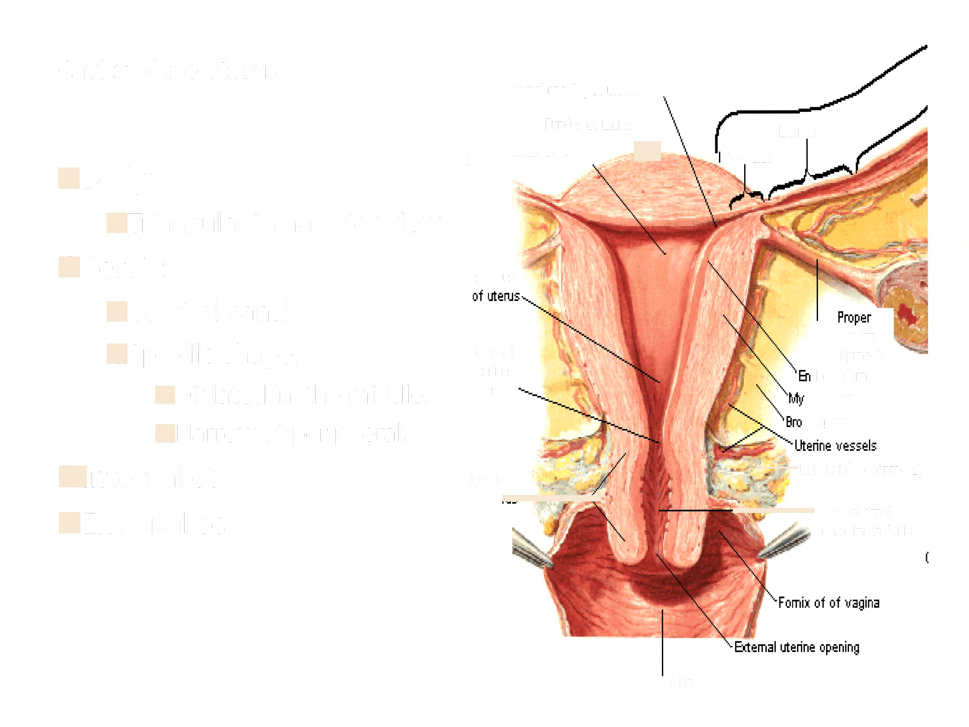
Anatomy of Uterus: CERVIX
The lower part of uterus.
Its lower end is clasped by the vault of the vagina.
Has:
2 parts: supravaginal & vaginal parts.
Canal: cervical canal.
The deep sulcus which surrounds the protruding cervix is the fornix of the vagina,
It is deepest posteriorly.
Internal os
cervix
Cervical canal
External os

Slide 7
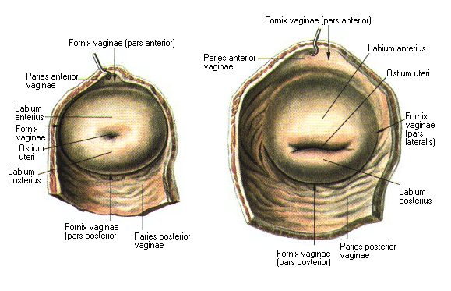
Anatomy of Uterus: CERVIX
Cervical canal:
Continuous with the cavity of the body at internal os.
The lower opening into the vagina is external os.
E O: is circular in the nulliparous but become transverse slit after childbirth.
E O: is normally on a level with the ischial spines.
Internal os
cervix
Cervical canal
External os

Slide 8
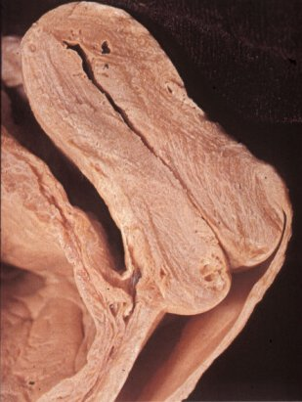
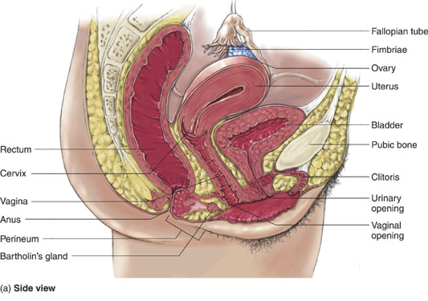
Anatomy of Uterus: PERITONEAL COVERING
Reflected from the superior surface of the bladder.
Then covers junction of the supravaginal portion of the cervix and the body of the uterus
Here it forms Uterovesical pouch.
Then covers body, fundus, posterior surface of body and the supravaginal part of cervix.
Then covers upper third of posterior surface of vagina.
Then reflected on anterior surface of middle rectum, to form rectouterine pouch {of Douglas}.

Slide 9
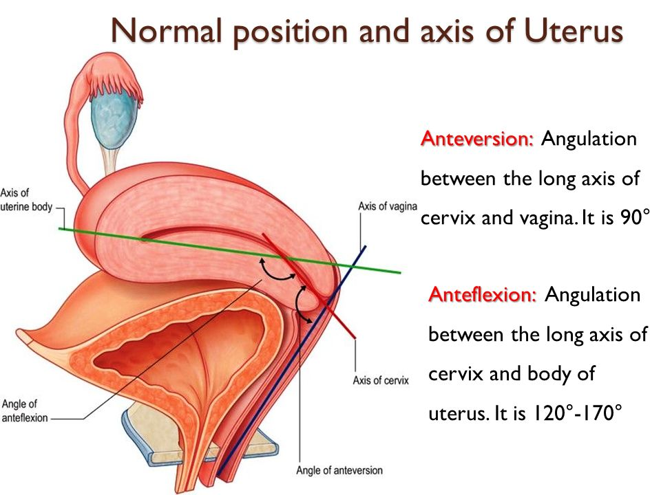
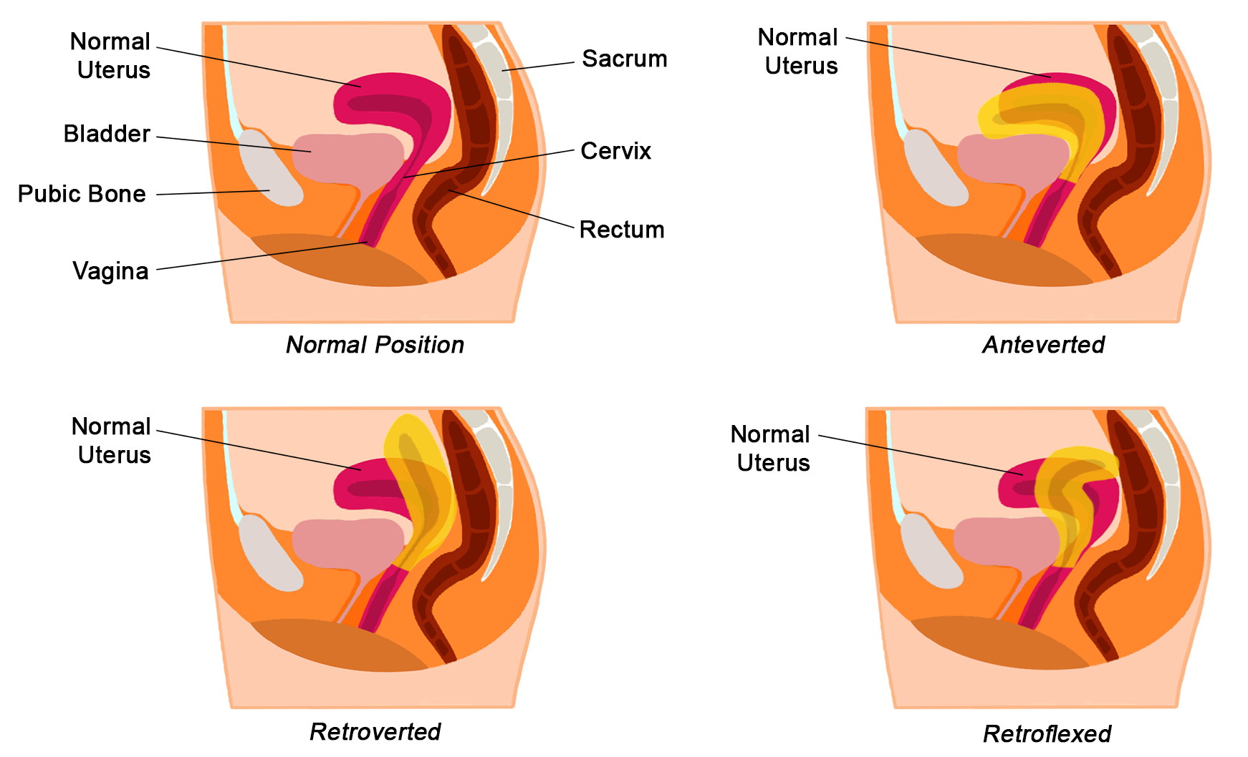
Anatomy of Uterus: POSITION
The normal position is:
Anteverted, Anteflexed.
Other positions for normal uterus:
Anteverted.
Retroverted.
Retroflexed.

Slide 10
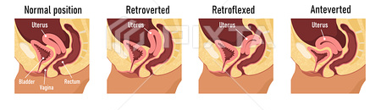

Slide 11
Anatomy of Uterus: RELATION
Anteriorly:
The body: related to the uterovesical pouch and the superior surface of the bladder.
The supravaginal cervix: related to the superior surface of the bladder.
The vaginal cervix: related to the anterior fornix of the vagina.
Posteriorly:
Related to rectouterine pouch (pouch of Douglas) with coils of ileum or sigmoid colon within it.

Slide 12
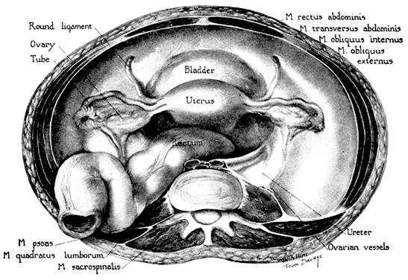
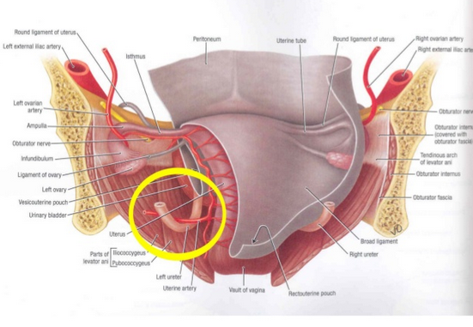
Anatomy of Uterus: RELATION
Laterally:
The body: related laterally to the broad ligament and the uterine artery and vein.
The supravaginal cervix: related to the ureter as it passes forward to enter the bladder.
The vaginal cervix: related to the lateral fornix of the vagina.
The uterine tubes enter the superolateral angles of the uterus.
Round ligaments of the ovary and of the uterus are attached to the uterine wall just below this level.

Slide 13
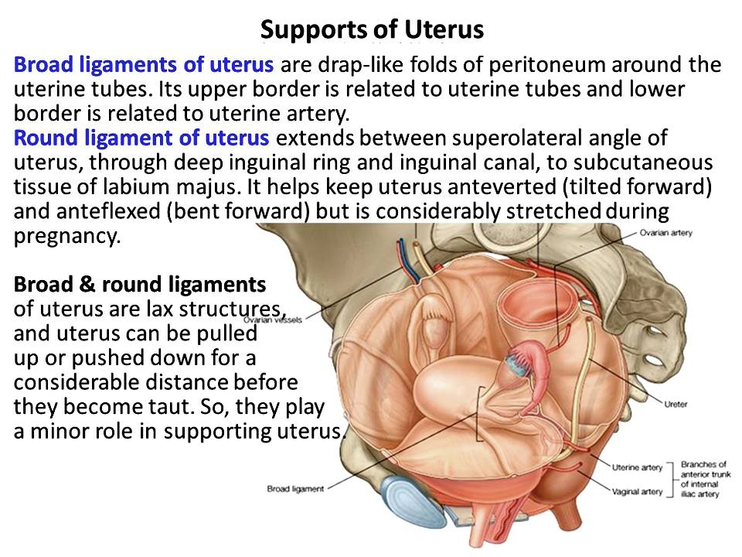
Anatomy of Uterus: SUPPORT
The most ﬁxed part of the uterus is the cervix.
Some of structures share directly or indirectly in support of uterus.
Structures include:
Upper structures: {Round & Broad Ligaments}.
Middle structures: {Transverse, Uterosacral ligaments}.
Lower structures: {Levator ani, coccygeus, Perineal body}.

Slide 14
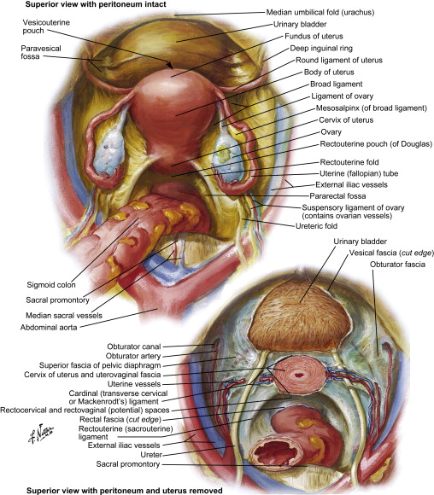
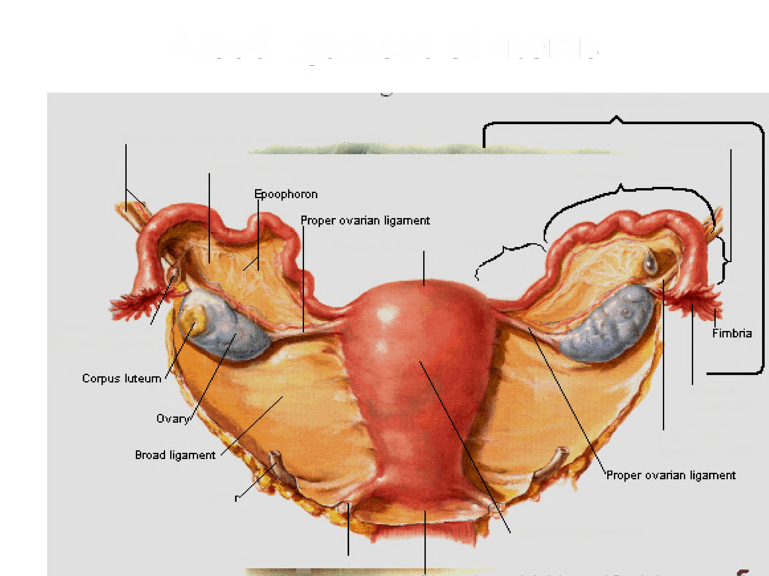
Anatomy of Uterus: SUPPORT
Broad Ligament:
A double fold of peritoneum lying lateral to the Uterus.
It plays little part in uterine support.
Its medial edge is attached to the side wall of the uterus.
The lateral edge is attached to the side wall of the pelvis.
The line of lateral attachment crosses the obturator nerve, superior vesical vessels, and the obturator vessels.
Upper border of the broad ligament is free, forming the mesosalpinx {containing the uterine tube}.
Lateral part of mesosalpinx forms the suspensory ligament of the ovary (infundibulo-pelvic).
Suspensory ligament contains the ovarian vessels and lymphatics.
SUS LIG
Mesosalpinx

Slide 15
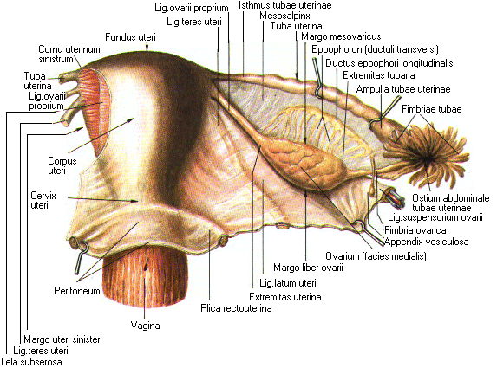
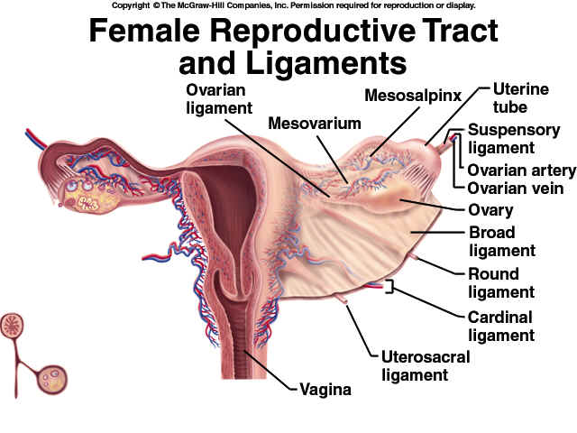
Anatomy of Uterus: SUPPORT
Broad Ligament:
Anterior layer: bulged forwards by round ligament of the uterus just below uterine tube.
Posterior layer: bulges backwards as mesovarium, suspending the ovary.
Between the two layers is a mass of areolar tissue, in which lies:
Uterine and ovarian vessels and lymphatics.
Round ligament of the uterus.
ligament of the ovary.
Vestigial remnants of mesonephric tubules (epoophoron and paroophoron).

Slide 16
Anatomy of Uterus: SUPPORT
Round Ligament:
Extends from junction of the uterus and tube to the deep inguinal ring.
It lies in the anterior layer of the broad ligament below the uterine tube.
It is continuous with ligament of the ovary {the two ligaments in continuity representing the gubernaculum}.
It passes through the inguinal canal and is attached at its distal extremity to labium majus of the vulva.
It is supplied by:
A branch of the ovarian artery in the broad ligament.
A branch from the inferior epigastric artery in the inguinal canal.
It consists largely of visceral muscle.
Acts to hold the uterus forwards in anteﬂexion and anteversion.

Slide 17
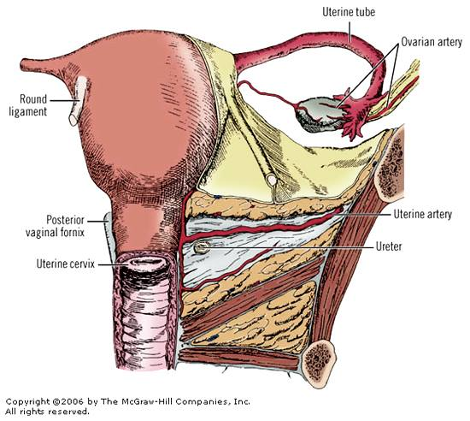
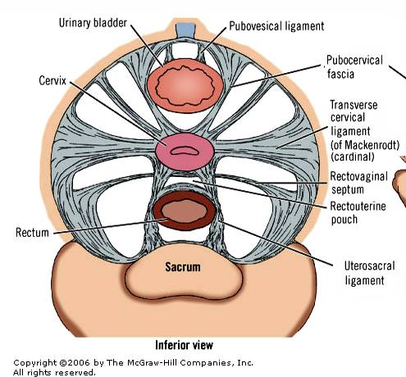
Anatomy of Uterus: SUPPORT
Transverse or Lateral Ligament:
Known as the lateral cervical, cardinal or Mackenrodt's ligament.
Consists of thickenings of connective tissue in the base of each broad ligament.
Extending from the cervix and vaginal fornix laterally to the side wall of the pelvis.
Its upper surface related to ureter, uterine artery and inferior hypogastric plexus.
It pierced by cervical branch of uterine artery.
Its function: lateral stability to the cervix.

Slide 18
Anatomy of Uterus: SUPPORT
Uterosacral Ligament:
Consists of condensation of connective.
Extending backwards from the cervix below the peritoneum.
Embracing the rectouterine pouch and rectum.
Becoming attached to the fascia over piriformis.
It is best palpated on rectal (not vaginal) examination.
It keeps the cervix braced backwards against the forward pull of the round ligaments on the fundus.
Maintains the body of the uterus in anteversion.

Slide 19
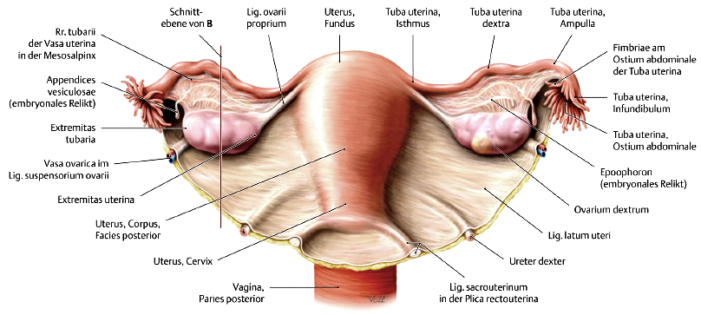
UTERINE TUBES
Muscular tube runs in the upper border of the broad ligament.
Each tube:
Is 10 cm (4 in) long.
Has two ends.
Formed of four parts:-
Infundibulum.
Ampulla.
Isthmus.
Intramural.

Slide 20
UTERINE TUBES
It embraced by double fold of peritoneum (mesosalpinx).
Isthmus: straight & narrowest part.
Ampulla: the widest part, site of fertilization.
Infundibulum:
Trumpet-shaped expansion.
Ended by several ﬁnger-like processes (fimbria).
It is the open end.
Lies behind the broad ligament adjacent to the lateral pelvic wall and ovary.

Slide 21
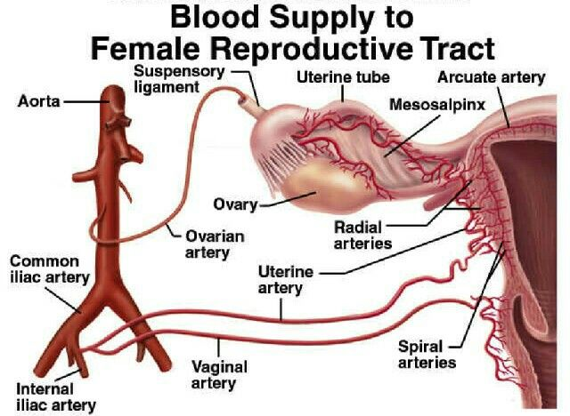
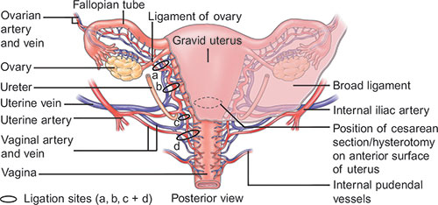
Blood supply of uterus and uterine tubes Arteries
Uterus:
It is supplied by the uterine artery.
Branch from internal iliac.
It passes medially across the pelvic ﬂoor in the base of the broad ligament,
Reaches the side of the supravaginal part of the cervix.
Giving a branch to the cervix and vagina.
At entrance of the tube; it anastomoses with tubal branch of the ovarian artery.
In its course; it freely gives off branches which penetrate the uterine walls.

Slide 22
Blood supply of uterus and uterine tubes Arteries
Uterine tube:
It is supplied by tubal branch of ovarian artery.
The tubal artery runs below the tube.
Between the layers of the broad ligament.
Anastomose with the uterine artery.

Slide 23
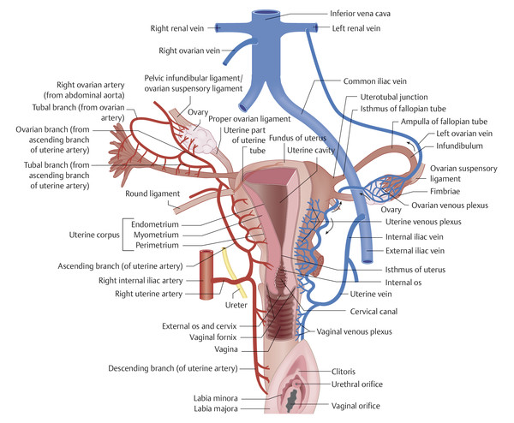
Blood supply of uterus and uterine tubes Veins
The veins of the uterus course below the artery at the lower edge of the broad ligament.
They form a plexus across the pelvic ﬂoor.
This communicates with the vesical and rectal plexuses.
It drains to internal iliac veins.
The tubal veins join the ovarian veins.

Slide 24
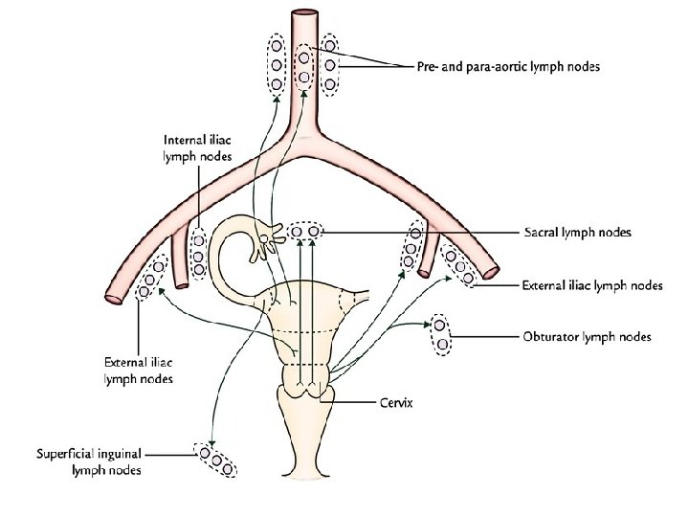
Lymph drainage
The body and fundus of the uterus normally drain to:
Mainly to external iliac nodes.
Also possible to reach the inguinal nodes via the round ligament and the inguinal canal.
The cervix drains to external and internal iliac nodes.

Slide 25
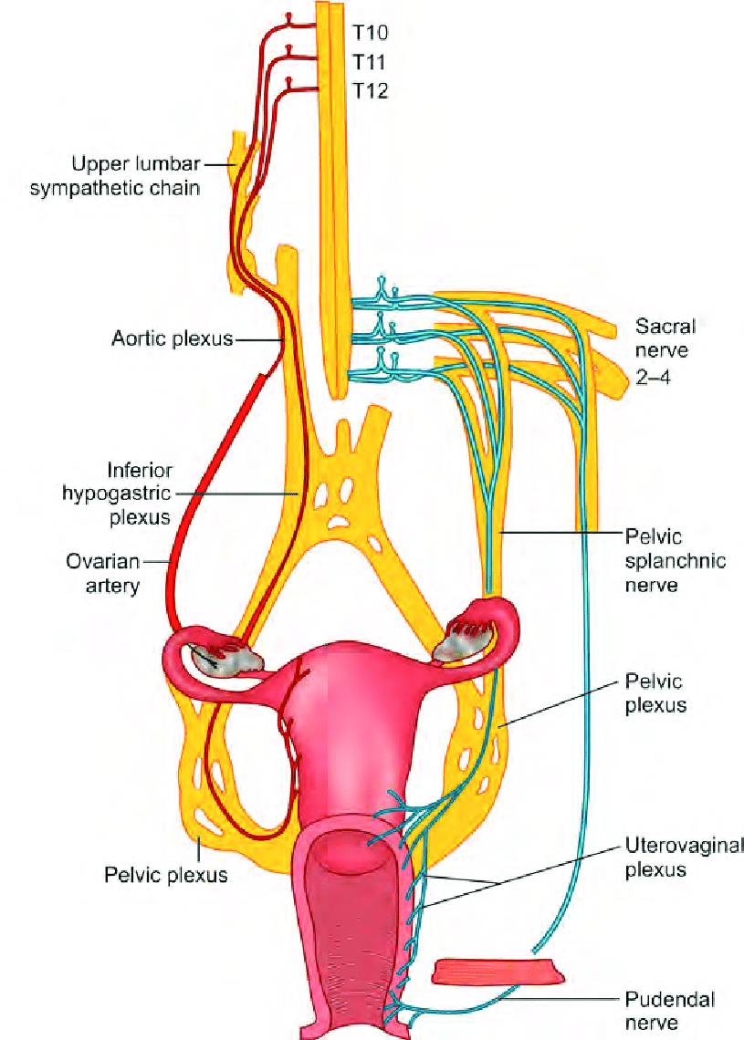
Nerve Supply
The nerves of the uterus are branches from the pelvic plexus.
The nerve supply for sense largely.
Pain from lower 2\3 of cervix pass through pelvic splanchnic nerves (parasympathetic) (vagus & S2, 3, 4).
Pain from upper 1\3 of cervix & body pass through sympathetic (T10 to L1 or L2).

Slide 26
10X

